Slide 1
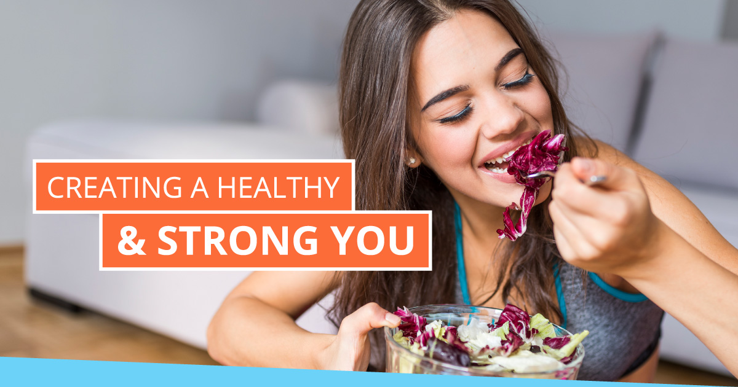
Notes:
Ken: Change this pic…

Slide 2
“Everyone is FOCUSED on the Strength of the VIRUS…
And No One is FOCUSED on the Strength of the HOST”
Notes:
THE PREMISE – Today everything I tell you will be focused on Strengthening the Host… Then you and your family will be better able to take on any disease.

Slide 3
Notes:
We spend more money on healthcare than any country in the world!

Slide 4
BLOOMBERG 2019 HEALTHIEST COUNTRY INDEX
Notes:
#35?
$2.6 B SPENT ON “HEALTHCARE”
#1 IN SPENDING IN THE WORLD
#35
WTF?
UNACCEPTABLE? HANDS-UP

Slide 5
How can a country that spends more than any other country in the world on healthcare be so susceptible to COVID-19 and other diseases?
Notes:
What is it that we are not seeing? What are we not connecting?

Slide 6
People have never been sicker.
“For the first time in the history of man,
children born after the year 2000 are not expected to live as long as their parents.”
Centers for Disease Control 2009
Notes:
People have never been sicker.
OBESITY IS THE LYNCH-PIN TO CHRONIC DISEASE
THE TREATMENT OF CHRONIC DX ACCOUNTS FOR
86% OF OUR $2.6 TRILLION DOLLAR “HEALTHCARE” BURDEN
LIFESTYLE DISEASE:
OBESITY AND SMOKING

Slide 7
DIABETES

Slide 8
HEART DX

Slide 9
CANCER

Slide 10
Notes:
Look at the steady recorded and projected steep trend line of Chronic Disease in the United States. These are people getting more and more chronic diseases. We should all be frightened by this…

Slide 11
Why is the US citizen so “susceptible” against these attacks – more so than at any time in our history?
Notes:
Ask yourself…

Slide 12
There are clues and correlations…

Slide 13
There is a direct correlation between obesity, its related diseases and immunity issues!
Notes:
The hidden villain in all of this…

Slide 14
Obesity Epidemic
Notes:
PROVE IT:
GENETICISTS TELL US THAT THE HUMAN GENOME HAS BEEN NEARLY UNCHANGED IN THE LAST 60,000 YEARS
(SOME IMMUNE SYSTEM ADAPTATIONS – EXPOSURE)
3700 GENERATIONS OF HUMANS….
OBESITY TRENDING SINCE 1985
GENES?
-----What’s happening?---
Fast Food – Junk Food – Too much food…
And this epidemic impacts all of us, whether we are obese or not… because of the food and movement choices we make…

Slide 15
Are YOU setting yourself up for a weak immune system right now? Are YOU doing the any of the following?
Eating sweets (sugar)
Overeating
Snacking
Stuck on the Couch
No sunlight
No movement
Wearing masks too much
No sleeping
Negative thinking (stinking thinking - FEAR rather than faith)
Lack of human contact (no hugging) marasmus (feeling bad and sad)
Lack of Socialization
Poor Air Quality
Poor Water Quality
Poor Nutrition
Drinking Alcohol
Yelling at Kids or others
And more…
Notes:
So are part of the epidemic… Ask yourself if you are doing any of these things…?

Slide 16
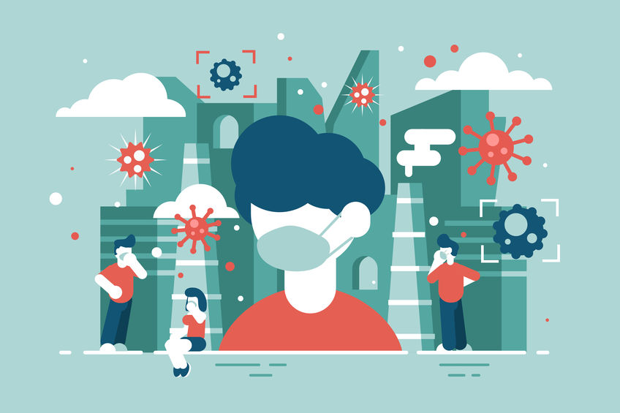
There have always been diseases challenging the human immune system daily throughout recorded history
Notes:
Diseases have always been part of our challenges, why is it so prevalent now? Ask yourself, “What has changed?”

Slide 17
Immunocompromised
Notes:
Define the term… it means their immune defenses are weakened and not functioning normally.
“These defenses, made of an army of cells with unique weapons that destroy invaders in the body, protect you against the common cold, bacteria, and viruses, and even cancer,” “When the defenses are low, an individual becomes highly vulnerable to infection
SO LET’S TALK ABOUT THE DIFFERENCE BETWEEN CONTAGEOUS AND DANGEROUS
DANGEROUS TO THE IMMUNOCOMPROMISED
SO WHAT YOU SHOULD BE ASKING IS….
WHAT DO I NEED TO DO TO MAKE SURE THAT I AM NOT IMMUNOCOMPROMISED?
WHAT DO I NEED TO START DOING OR STOP DOING TO REDUCE MY RISK?
REMEMBER – WE WANT TO SHIFT OUR FOCUS FROM THE STRENGTH OF THE VIRUS –
TO THE STRENGTH OF THE HOST

Slide 18
If you are Immunocompromised you are more susceptible to diseases such as COVID-19
Notes:
Let’s walk through a LOGIC Exercise in the next 3 slides…
FACT One:

Slide 19
If you are overweight/obese you are more likely to be Immunocompromised
Notes:
FACT 2

Slide 20
Therefore: If you are Overweight/Obese you are more susceptible to diseases such as COVID-19
Notes:
So the conclusion is:

Slide 21
Latest Research Supports This…
“Early data seems to suggest that people with obesity are more likely to become severely ill due to COVID-19, the disease caused by the novel coronavirus.
An increasing number of reports have linked obesity to coronavirus mortality, and the Centers for Disease Control and Prevention (CDC) now list obesity as a risk factor for severe COVID-19. The CDC define severe obesity as having a body mass index (BMI) of 40 or above.”
From Medical News Today – 5/6/2020
Notes:
A BMI of 30 is Obese
A BMI of 25 is overweight
18.5 to 24.9 in normal

Slide 22
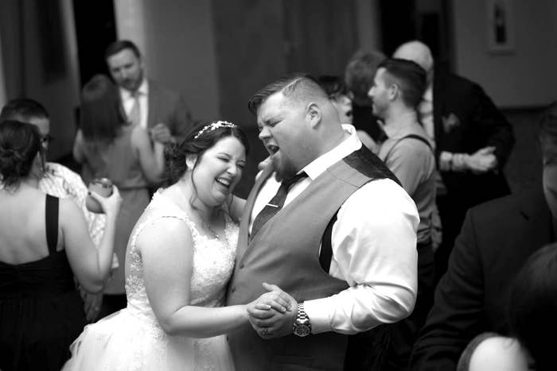
And the sad reality supports this…
From Buzzfeed News– 4/2/2020
Notes:
She's A Widow At Just 31. She Has A Message For You About The Coronavirus.
It was a blustery January day in 2018 when Lew Berry got down on one knee in the parking lot of the bowling alley in Fishers, Indiana, where he and Brianna Berry had gone on their first date a year and a half earlier.
Brianna didn’t believe it was really happening at first. Since they’d moved in together a few months prior, Lew had had some fun building up to the big moment, getting down on one knee a few times just as a prank. What Brianna didn’t know was he’d already bought a ring and was just waiting for the perfect moment. And there, outside the bowling alley where they’d begun their love story, that moment finally came.
“He said ... that first handshake changed his life, and he never knew he could be this happy,” Brianna, 31, told BuzzFeed News. “And he asked me to marry him.”
Brianna and Lew met for the first time in August 2016 at that very same bowling alley. They’d first connected on the dating site Plenty of Fish, months before Brianna was planning to relocate south from northern Indiana, and went on their first date after she’d moved there.
“We went bowling because he didn’t want to go to a movie, because he wanted to talk to me, and dinner was too formal,” she said. “It was just instant chemistry, instant connection. He was very easy to talk to and so funny — he could just make anyone laugh.”
She added, “At the end of that date, he asked if he could kiss me. He was just a gentleman in every way. We both described it later as the best kiss we’ve ever had.”
Their relationship sped forward after that. They cooked for each other and went on a date to the zoo and started spending more time together than they did apart. Eventually, they got a French bulldog named Rocco and bought a house together. And in November 2018, they married.
“That still is the best day of my life, and it was his too,” she said. “You just look at our wedding pictures and you can just tell how much we love each other.”
But Brianna can’t bear to look at the pictures now. Not since April 6, when Lew died of the coronavirus at age 37.
Brianna has been left struggling to come to terms with the death of the man she was married to for less than two years, and she’s at a loss to understand how a virus that leaves many unscathed could kill the love of her life.
“It’s still hard to believe sometimes — because it’s not like he was an old man,” she said. “It doesn’t make sense why some people die and some don’t.”
“Why am I still here and he’s dead?” she asked. “Why am I a 31-year-old widow?”
When the pandemic hit, Brianna said she and Lew took every precaution not to get sick, particularly since they both had asthma. They socially distanced. They washed their hands. They wiped down all the surfaces in their home.
But still, over the last weekend of March, Lew developed a cough, shortness of breath, and a fever. The following Tuesday, March 31, his symptoms had become so severe the pair went to a hospital, where he tested positive for COVID-19.
[The doctors] told me he was going to be on a vent, so we FaceTimed,” she said. “He told me everything was going to be okay, he was going to fight, and that I was the best thing to ever happen to him, and the years with me were the happiest of his life.
“He told me to be strong, and I told him I loved him and I can’t lose him. And we stayed on FaceTime together until they were going to put the vent in.”
Even while her husband was being intubated, Brianna still didn’t imagine that would be the last time they spoke.
“Never in a million years did I think he wasn’t going to make it,” she said.
Then came the waiting. Brianna waited as the doctors treated Lew, which she described as an emotional roller coaster — hope, then despair. One day, his fever went down, and she thought he was out of the woods. But then it climbed back up again.
On April 5, the doctors told Brianna her husband was going to die. Due to the hospital’s regulations meant to prevent the spread of the virus, she wasn’t allowed to come in and be with him.
“Every night in the hospital, I would have them put me on speakerphone, and I’d sing to him and talk to him and tell him how much I loved him,” she said.
Around 1:30 a.m. on April 6 came the call she’d been dreading.
“I was alone because I was under quarantine,” she said of the moment. “I just remember falling on the floor and screaming.”
Lew was a project manager for a family-owned construction company, which he started working for when he was just 15. The company’s owner, Todd Lewis, 55, told BuzzFeed News he had been in need of some strong workers, and when he ran into the young Lew and some friends on the street, he offered them jobs. Lew started working for the company and never stopped.
Lew turned out to be a skilled worker and grew close to Lewis and his family over the years. In recent years, the two men coached a youth football team together.
“We treated him as one our own, and he became one of our own,” Lewis said.
Months into Lew and Brianna’s relationship, he invited her to Lewis’s Thanksgiving dinner. Lewis laughed, remembering that Lew had been so excited to finally introduce his girlfriend to him that he'd showed up an hour early.
“Something was missing for Lew, and he found Bri, and that filled that hole for him,” Lewis said. “He became a lot happier. She made him very, very happy.”
Despite being the one to deliver Lew’s eulogy at a funeral attended by just six people, Lewis is still in shock. He hasn’t yet been able to grieve the death of his longtime friend.
“Lew had been such a big mountain of a guy that I just never thought anything like that would take him down,” Lewis said.
As part of the eulogy, Lewis read out a list of memories that Brianna had written about her relationship with Lew.
“I had been journaling my memories because I’m afraid I’ll forget them,” Brianna said, “because I feel like we didn’t get enough of them, so I don’t want to forget the ones that we did get.”
Because of social distancing guidelines and fears that she may be carrying the virus, Brianna has been mostly alone as she processes her grief. Her mother is staying with her, and she has videochatted with people, but Brianna said she feels so alone and does not know what her life will look like from here.
“I feel like I’ve been robbed of my life with him,” she said. “It’s like, why is it that other people just find their person and be happy, but mine is taken from me so soon? We never even really got to decide if we were going to have children or not.”
Coupled with her grief, Brianna said she’s overcome with anger and frustration for those she sees as not taking the virus seriously enough, like people not properly social distancing and officials rushing to reopen businesses.
“Don’t think that just because you’re young and healthy that you’re not going to get it,” she said. “It’s not just the elderly, and people need to take this seriously — it's not a joke.
“It is so much worse than I think we were led to believe. Experiencing it firsthand, it is an awful way to die.”

Slide 23
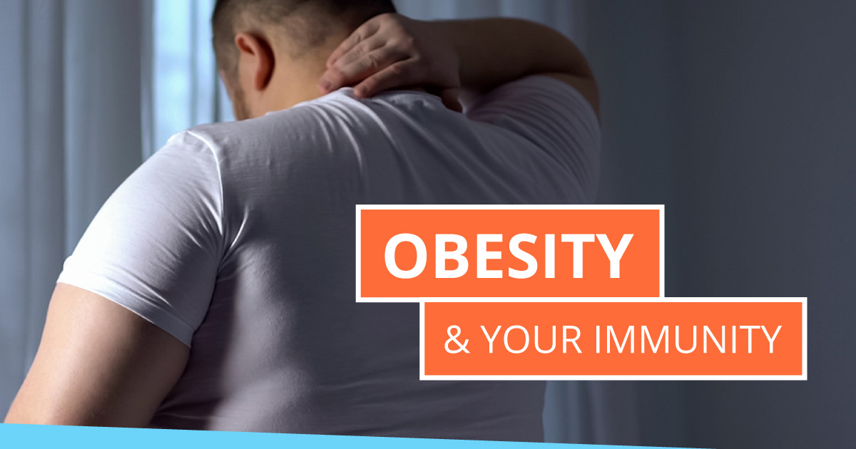
Notes:
Abdominal obesity, or visceral fat, is the most obvious clue to metabolic syndrome. Again, the risk factors tend to cluster, and visceral fat, which wraps around the abdominal organs, causes insulin resistance.
In fact, adipose tissue in obese people is itself insulin resistant, causing a further sequence of metabolic and inflammatory problems.
That excess inflammation is what ultimately weakens the body’s immune response and reduces its ability to fight pathogens.

Slide 24
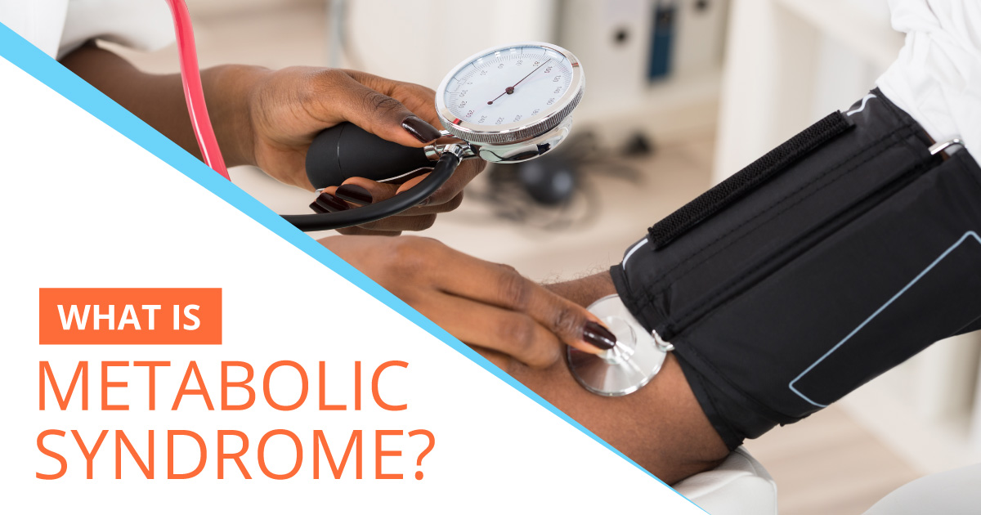
Notes:
Metabolic syndrome isn’t a disease, but a group of risk factors that increase your risk of several diseases. Five risk factors are considered when diagnosing metabolic syndrome, but only three factors need to be present for a positive diagnosis:
High blood pressure
High fasting triglycerides (triglycerides are the end product of digesting and breaking down fats in food.)
Low HDL cholesterol (high-density lipoprotein, aka “good” cholesterol)
High fasting blood glucose (insulin resistance)
Abdominal obesity
Covid 19 has turned the cormorbidities of metabolic syndrome from Chronic into Acute Acute Crisis

Slide 25
Notes:
The complications of untreated metabolic syndrome and the conditions that it is made up of are frequently serious and long-term. Here is some information you should know:
People with metabolic syndrome have a risk of heart attack and stroke that is double the risk of people who do not have metabolic syndrome.
Metabolic syndrome increases the risk of developing diabetes by five-fold. If diabetes develops, you may be at risk for eye damage, nerve damage, kidney disease, and the need to amputate limbs.
Other issues that may develop include the hardening of the arteries, kidney disease, nonalcoholic fatty liver disease, and peripheral artery disease.
Basically, when your body is operating under less-than-ideal conditions (like coping with high blood pressure or regulating inappropriate amounts of insulin), it doesn’t have enough fight in it left to adequately protect itself from outside viruses, germs, and bacteria.

Slide 26
Notes:
By now you’re probably wondering, ‘what exactly is insulin?’
Insulin is a hormone made by your pancreas that helps sugar enter your cells to be used as energy.
Normally, your digestive system breaks down the foods you eat into sugar. However, for people with insulin resistance, cells don't respond normally to insulin, and glucose can't enter the cells as easily.
As a result, your blood sugar levels rise even as your body churns out more and more insulin to try to lower your blood sugar. Eventually, the pancreas may wear out from working overtime, and may no longer be able to produce enough insulin to keep blood sugar levels in check.
Research has shown that the immune cells that help safeguard the immune system are regulated by metabolic signals that they receive from insulin.
Therefore, if your insulin levels are not healthy, your immune system won’t work as well as it could be.

Slide 27
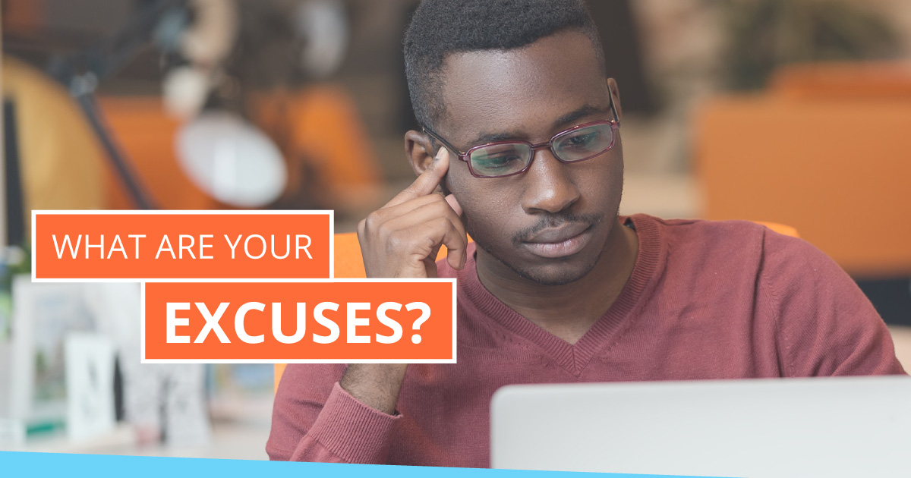
Notes:
You may have created excuses for not living their ideal healthy lifestyle.
“I don’t have time.”
“My job doesn’t make it possible.”
“I can’t afford a healthy lifestyle.”
“I don’t know how to be healthy.”
These excuses are common, but frankly aren’t real barriers that stand in the way of you being a healthy person. In reality, your excuses are only based around habits that you’re afraid to break because you feel more comfortable where you are. “My mud puddle may be cold to sit in, but it’s my mud puddle.”
All the excuses are hurdles, for sure, but they don’t have to be barriers.

Slide 28
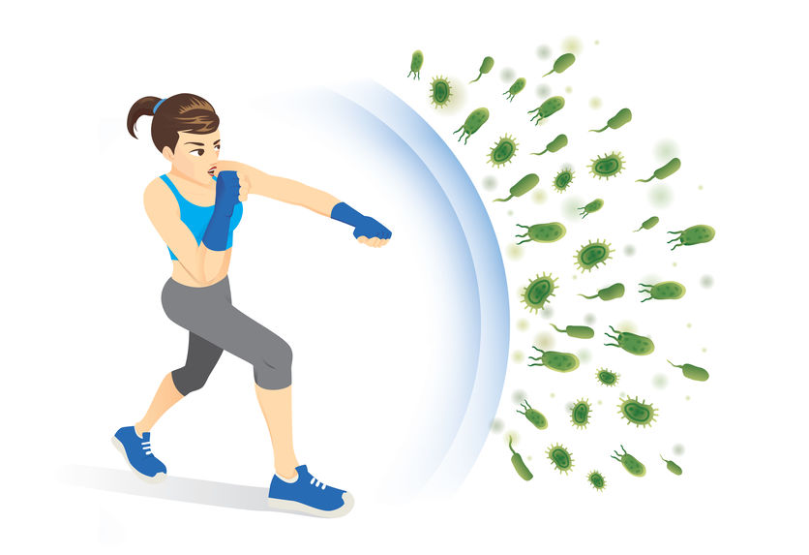
How can we fight back?

Slide 29
Notes:
Finding the “time” for creating healthier habits is a challenge for people.
We won’t lie, it does take time to implement a healthy lifestyle, but it doesn’t have to be a major shift that forces you out of your comfort zone all at once.
In order to create “time” in your already full schedule, stick to baby steps. Plan out grocery lists that include healthier options. Do some mini workouts while you watch TV. Schedule a walk with someone you would normally sit and talk with. Take the stairs instead of the elevator.
By shifting how you spend little pockets of time, you’ll begin to make a change that can sustainably keep up with and add to over time.

Slide 30
Notes:
If you’re serious about improving your health, it’s important to make it easy for yourself to make good choices.
Take a moment to think about what’s in your refrigerator and pantry. Are there healthy options to reach for? Are those healthy options something you actually WANT to eat or do the fruits and veggies you buy usually go bad because you reach for a less healthy option instead?
When it comes to exercise, do you seek out opportunities to move your body, or avoid them at all costs? For example, when you could easily walk somewhere, would you typically opt to drive instead?
Every day we’re faced with dozens of choices that can either contribute to our health or take away from it.
Fill your pantry with foods that nourish you instead of comfort foods. Plan activities that involve moving instead of sitting around. Before you know it, your lifestyle will shift.

Slide 31
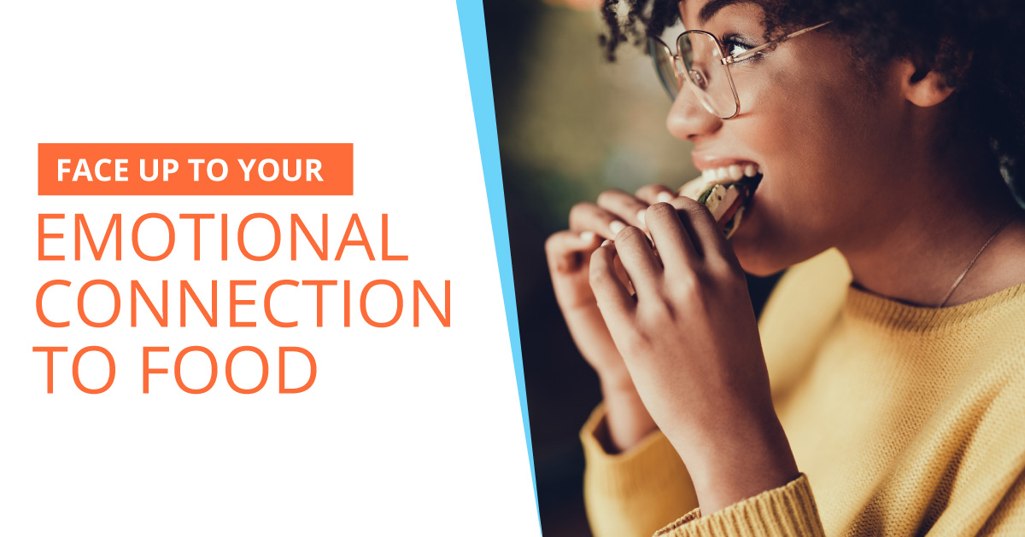
Notes:
Culturally, food has always been tied to emotions and memories.
We bake cakes to celebrate and we feast on special occasions. These ties we have to food create connections and habits that can lead to using food as a crutch when we’re feeling down.
Take a moment to think about this. When you’re feeling stressed, what do you eat? What about when you’re feeling sad or sorry for yourself? In situations where your emotions are running high, do you turn to food as a way to comfort yourself?
Part of your journey involves deciding why you make the food choices that you do, then making conscious choices to take back that power you’ve given to food.

Slide 32
Notes:
Making any change in your life is difficult, and it’s even more difficult when you don’t have support.
When it comes to improving your health, it’s important that you have a sense of accountability, someone or something to provide you with confidence when you need it, and access to knowledge from someone who’s been where you’re at now.
In short, having support can make all the difference in overcoming barriers to living a healthy lifestyle.

Slide 33
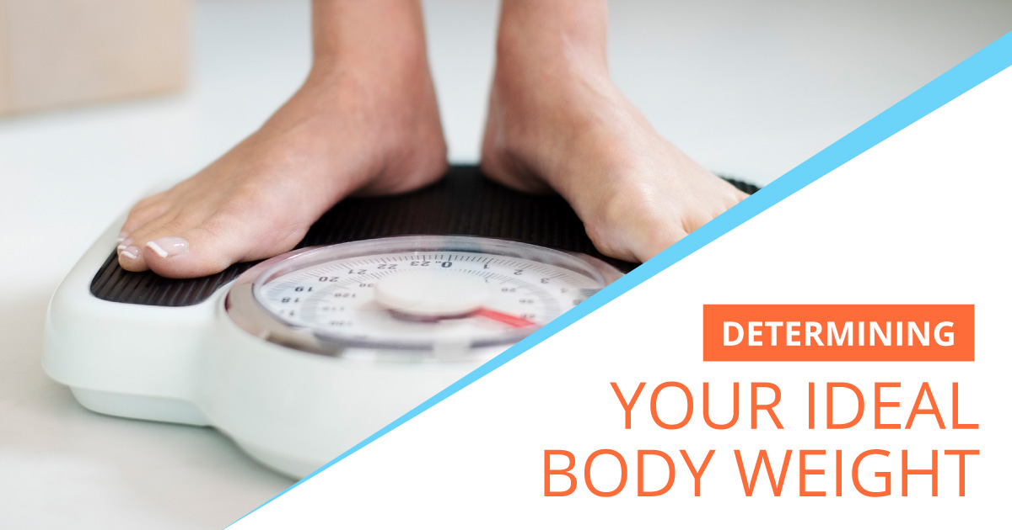
Notes:
The concept of ideal body weight is an imperfect one and is not indicative of health.
Instead of worrying about how to determine your ideal body weight from a formula, shift your focus to health and happiness. Think back to when you felt your healthiest and happiest and were eating well without starving yourself, and make that your goal.
Ideal body weight is about so much more than a number on the scale. It has to reflect a doable, sustainable lifestyle with a focus on setting your health up to sustain you for the long haul.

Slide 34
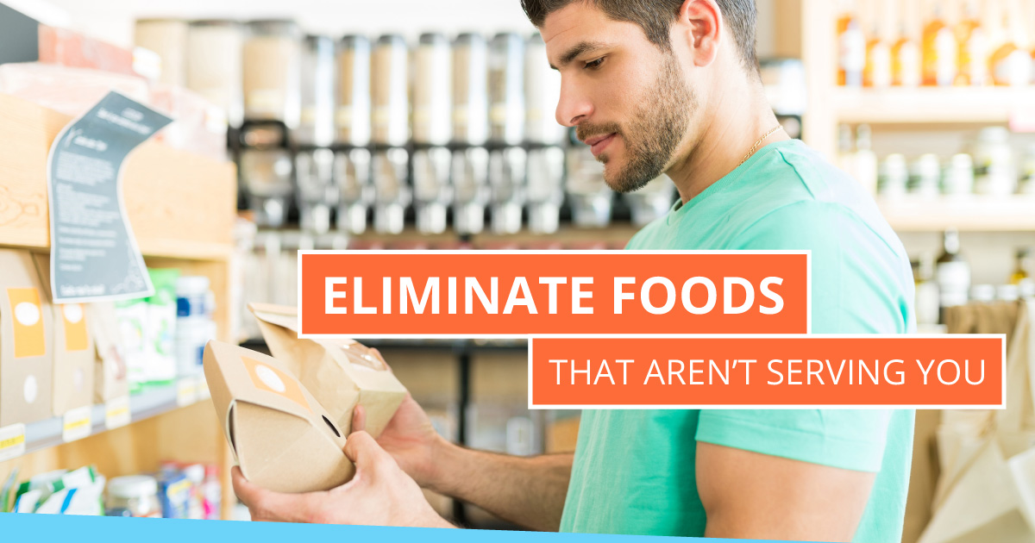
Notes:
If it comes in a box, can, or microwaveable bowl, you can bet it’s loaded with preservatives, additives, and sugar.
One helpful tip to keep in mind is acknowledging the layout of a grocery store. For example, the foods found in the middle aisles are often found with the ingredients you’ll want to avoid, including added sugars in the form of sucrose and high-fructose corn syrup. They lead to increased inflammation and insulin surges that increase the risk of diabetes and metabolic syndrome.

Slide 35
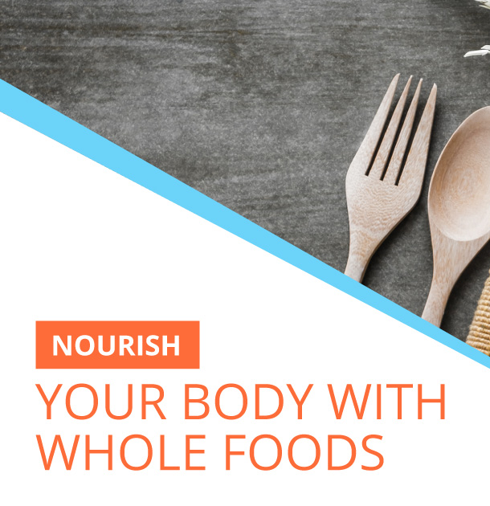
Notes:
What’s best is to stick to the perimeter of your grocery store when shopping, and start in the produce section. Walk through slowly and look at all the vibrant colors. Notice that everything looks as it does in nature prior to being harvested. Those colors and textures are loaded with life-benefitting nutrients — vitamins, minerals, fiber, protein, healthy fats.
Start to eat a regiment to build a healthful, energizing diet from these nourishing “real” foods.

Slide 36
Notes:
Exercise improves your blood values, increases your testosterone and growth hormones, decreases depression and the risk of chronic disease, and boosts energy. And of course, regular exercise can help support your immune system!
Lucky for you, your body is designed to move, all you have to do is activate! Indulge your inner yearning to experience your body’s own strength and endurance by filling your days with activities that you ENJOY doing.
Take a walk around nature.
Dance to music that makes you happy.
Lift weights.
Do yoga.
Create a monthly challenge for yourself and work on it a little bit every day.
Whatever you do, turn off your inner critic and tap into the gratitude you have for your body and all that it allows you to do.

Slide 37
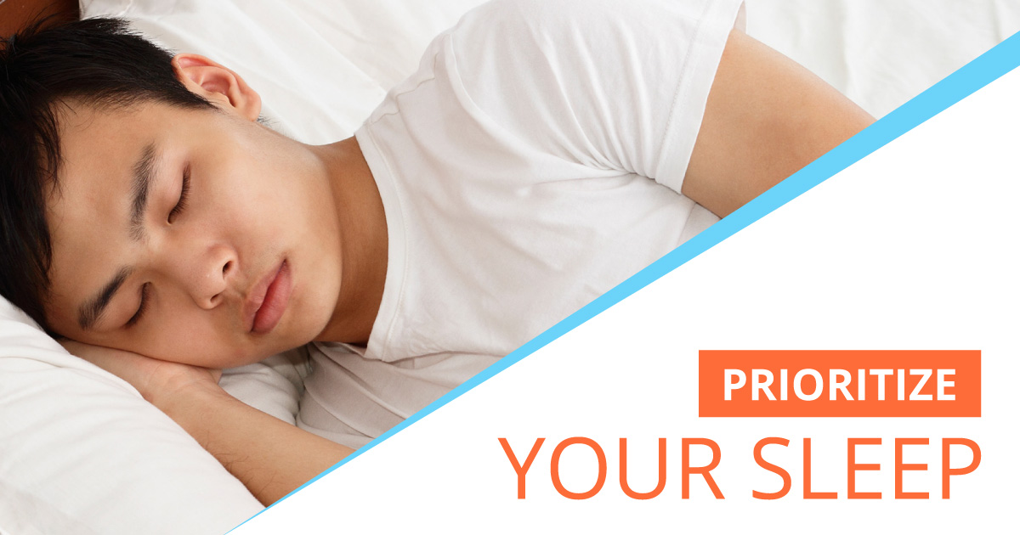
Notes:
Sleep is nature’s nurse. It allows your body and brain to rest and heal, and you need that time for everything to work at its full capacity when you’re awake.
Create a ritual around your bedtime:
- Try to go to bed at the same time every night, and wake up at roughly the same time every morning.
- Avoid sugar and caffeine before bedtime, and brew yourself a cup of tea or warm water instead.
- Turn off all your overhead lights an hour before you go to sleep to prepare your body for rest. - Strive for eight hours of quality sleep.
Sleep is a crucial component of health - ensuring there is enough time to recover from the day that has passed as well as recharging us for what we plan to take on tomorrow. The quality of our sleep can affect everything from our immunity to our mood, so sleep tight!

Slide 38
Notes:
Perhaps the most understated of the simple rules for healthy living is minimizing stress. It’s the one life hack that doesn’t fit into a shopping cart and can’t be measured in reps, miles, or hours.
Stress is, however, the one silent danger that creates “leaks” in your life, allowing unhealthy habits to sneak in. An after-work drink sounds better than an hour-long workout. A candy bar is so much easier in the moment than sautéing a bunch of vegetables. And sleep is pushed aside when there’s a big commission on the line.
Before you know it, you’re going against all the rules for healthy living. And the cortisol production set off by stress drives fat straight to your belly, increases your risk of chronic disease, and impairs your metabolism.
Prioritize not only minimizing your stress, but also finding healthy and effective management techniques. How do you currently manage your stress?

Slide 39
Notes:
Staying focused on long-term goals is crucial to staying on track, but so is managing short term expectations. Because when you wake up each morning, you need to know specifically what to do in order to reach those long-term goals, right?
This is why it’s important to create a plan that you can stick to. Pre-planning a routine sets aside mental space to simply execute the plan instead of worrying about what to do next.
And again, part of sticking to this plan is having a support system to turn to when you need a little boost of confidence or accountability.
Plan your work and work your plan

Slide 40
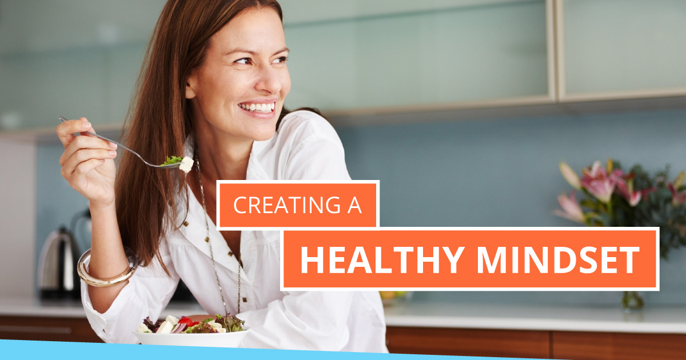
Notes:
There’s a fine line between being health-centric, and health-obsessed, and you don’t want to be the latter.
Getting too obsessive about what you put in your body and how many calories you burn during a workout will actually create more stress in the body, and your efforts will likely backfire.
It’s important to remember that whatever you do HAS to be sustainable and make you feel better about yourself, NOT worse.
Have you had challenges with adopting a healthy mindset when trying to achieve your health goals?

Slide 41
Notes:
Story… Grandpa’s Wishes…

Slide 42
Six Step Plan
Assess your current health markers
Target your improvement goals
Plan the actions that will take you closer to your goal
Track your movement towards your goal
Adjust your plan
Repeat until you achieve the level of health you need to resist disease

Slide 43
What are your first steps?
Enter your Zip which will get you…
An introductory call with a Health Professional
Then set up your SprintSet Body System Assessment
Which will measure your health markers
Resulting in a report on your Body System Assessment
Planning your strategy with your Health Professional…

Slide 44
If you are ready for a stronger, healthier you…
Make a decision,you have the freedom of choice!
Take action NOW!
Let us help you walk down the path to a stronger immune system and a healthier you NOW!
Type your name and zip code into the chat box
You will be contacted for a Telehealth Call by a SprintSet Health Professional
Notes:
Text this…

