Slide 1
Facebook Live

Slide 2
How to broadcast Facebook Live via Mobile

Slide 3
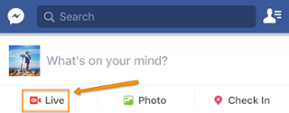
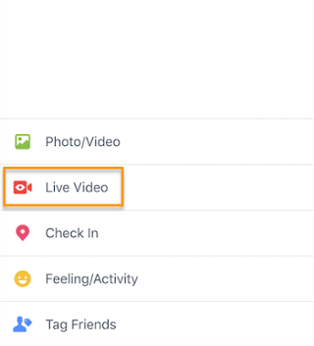
Step 1
Step 1: To get started, get out your mobile device and open up the Facebook app.
Go to the News Feed and tap the “Live” option denoted by the camcorder icon.
You can also go live on your own Facebook profile. Open up the status bar by tapping the text that reads "What's on your mind?" Then, select the "Live Video" option from the menu.

Slide 4
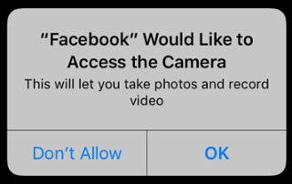
Steps 2, 3 and 4
Step 2: Give Facebook access to your camera and microphone when prompted.
Step 3: Choose your privacy setting.
If you're posting for a brand, you'll probably want to make it public. If you're posting as yourself, you might want to reserve your broadcast for friends. But if you're new to Facebook Live and want to test it out first, or want to see what something will look like, then switch the privacy setting to "Only Me." You can find the "Only Me" option by clicking "More" and scrolling all the way to the bottom.
You’ll stop receiving these prompts after the first time you use it:
Step 4: Write a compelling description.
Give your broadcast a description, which will show up on people's News Feeds like a status update above the video. To get people to tune in, write an attention-grabbing headline and help them understand what your broadcast is about.

Slide 5
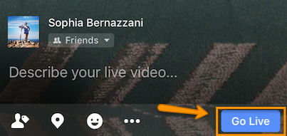
Steps 5, 6 and 7
Step 5: Click the blue “Go Live” button to start broadcasting.
Once you click it, Facebook will give you a countdown -- "3, 2, 1 ..." -- and then you'll be live. As soon as you start streaming, your live video will appear in your News Feed -- and others' News Feeds -- just like any other post.
Your broadcast can be up to 90 minutes long. Keep in mind that the longer you broadcast, the more people who are scrolling through their News Feeds on Facebook will stumble upon your post.
Step 6: Interact with viewers and commenters.
To keep your viewers engaged, encourage them to interact with your live video (which will help your ranking in others' News Feeds). You can also interact with them both by speaking directly to them in your video and, if you want, by having someone else respond to comments from a desktop computer elsewhere.
Where can you see these comments? While you're broadcasting, you'll see the time elapsed on the top left along with the number of viewers, and comments will show up live on the bottom of your feed. They'll appear in reverse chronological order, like on Twitter, so keep in mind that the earlier ones may be farther down.
Step 7: Click “Finish” to end the broadcast.
Once you do this, the video will stay on your Timeline or Page like any other video post.

