Slide 1
Emotions Cause More Than Feelings…
Notes:
We know what’s out on the streets…... We’re excited to give you the raw truth.
Happy to share valuable information that will support you with taking your health to the next level.
Angela- tell my struggle (eating disorder, worked out 6 days wk, competed, ate clean)

Slide 2
Let’s be honest……What stresses you?
Physical: You experience infections (like Lyme, EBV, herpes etc) or suffer allergies and food sensitivities. Excessive sports like marathon running and over-exercising can cause or worsen adrenal fatigue.
Emotional: Caused by issues like work pressures, financial or relationship problems. Past unresolved trauma and abuse. Feeling unworthy, not good enough, pushing yourself to over-achieve all the time. (That was certainly me!)
Chemical: Your liver is overloaded by toxins coming from xenoestrogens, antibiotics, prescription drugs; or you have lived or worked near places (like factories or farms) that are highly toxic. Chemo and radiation can also contribute.
Spiritual: You feel a lack of purpose or direction in life.
Dietary: A period spent overloading on caffeine, carbs and high-sugar foods can stimulate repeated cortisol release, setting up the adrenal fatigue pattern. Chronic gut issues like constipation, diarrhea, bloating, IBS, “leaky gut” and unaddressed food sensitivities can also cause adrenal fatigue.

Slide 3
This is my story and how I found my way…
COACH CONNIE
INSERT YOUR STATS
Notes:
Edify Connie – Show Before/After

Slide 4
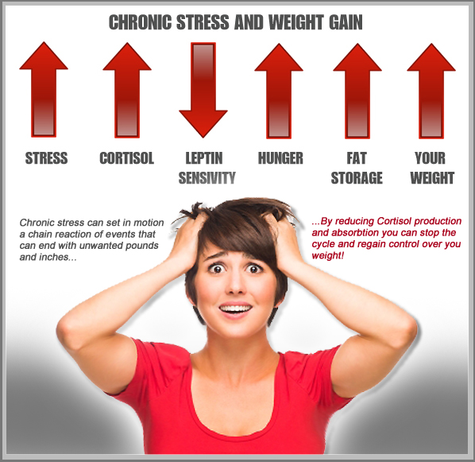
Your Body On Stress….
Notes:
How many of you can relate to this???
Connie- tells her struggle (over worked, over stressed, fad diets to lose quick)

Slide 5
Fact or Fiction – Let’s Play!
“OBESE” PEOPLE ARE UNHEALTHY
“THIN” PEOPLE ARE HEALTHY
Notes:
FICTION (angela)
You can weigh less on the scale, but can have high fat levels
Importance of having a BCA

Slide 6
Fact or Fiction – Let’s Play!
“MOVE MORE” OR “EAT LESS”
Notes:
FACT (Connie)… but other components must be addressed.
Simply telling people to eat less and move more isn’t enough.
Mindset/Attitude – I want to be my best weight, health, energy level.
Behaviors (habit changes need to be made, when, where, how we eat).
- Emotional (using food as a comfort, reward, sabotage, boredom, etc., i.e., emotional eating)
That’s like telling someone with depression to cheer up or someone with alcoholism to just drink less.

Slide 7
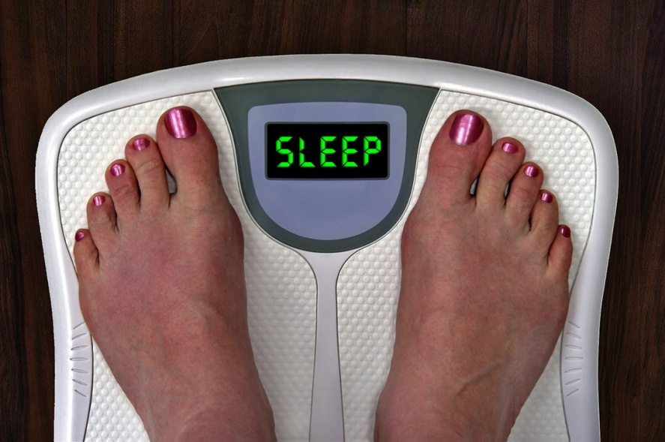
Fact or Fiction – Let’s Play!
SLEEP DEPRIVATION CAUSES
WEIGHT GAIN
Notes:
FACT (Angela)
Losing out on sleep creates a viscous cycle in your body, making you more prone to various factors contributing to weight gain. “The more sleep-deprived you are, the higher your levels of the stress hormone cortisol, which increases your appetite.

Slide 8
Fact or Fiction – Let’s Play!
CARBOHYDRATES:
GOOD OR BAD?
Notes:
FICTION (Connie)
Only simple carbohydrates should avoided (sugar, processed foods, refined grains)
- Causes a spike in blood sugar levels
Full of toxins

Slide 9
Fact or Fiction – Let’s Play!
EATING FAT MAKES YOU FAT
Notes:
FICTION (Angela)
Gives you energy
Supports cell growth
Supports brain function
Protects your organs
Helps with absorption of essential nutrients
Unprocessed whole foods: avocado, nuts/seeds, oils

Slide 10
Fact or Fiction – Let’s Play!
WATER IS IMPORTANT FOR WEIGHT-LOSS
Notes:
FACT (Connie)
Helps boost metabolism
Removal of toxins/waste
Delivery of nutrients throughout the body
Allows cells to deliver oxygen to muscles
HYDRATED CELLS REMAIN ALKALINE

Slide 11
Fact or Fiction – Let’s Play!
ALL CALORIES ARE CREATED EQUAL
Notes:
FICTION (Angela)
100 calories from an apple is not the same as 100 calories from a mini snickers bar.

Slide 12
Fact or Fiction – Let’s Play!
DIET FOOD CAN HELP YOU LOSE WEIGHT
Notes:
FICTION (Connie)
A lot of junk food is marketed as healthy. Explain the differences between whole foods and “diet” foods.

Slide 13
Fact or Fiction – Let’s Play!
LOSING WEIGHT IS A HEALING PROCESS
Notes:
FACT (Angela)
Not just about losing weight. Its about healing our bodies

Slide 14
TIME FOR – THE RAW TRUTH!
A few of our most important health secrets:
Stress levels
Remove toxicity on cellular level
90/10 rule
B.A.L.L.S
Notes:
(Angela)
Balancing blood sugar levels, metabolism & hormones
Getting rid of YEARS of toxins

Slide 15
WHAT IS YOUR WHY?
WHY?
Notes:
What is holding you prisoner?
Angela start with her why, then Connie

Slide 16
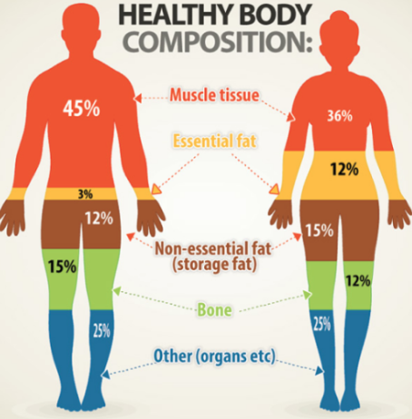
OUR GIFT TO YOU
A COMPLIMENTARY BODY COMPOSITION ANALYSIS
VALUED AT $150
Notes:
Our system SS is not just for weight loss. It will heal, energize, reset metabolism, balance hormones & blood sugar levels.
We have had almost 100% success rate. This is due to:
-personal coaching daily
-nobel prize winning technology (autophagy & behavioral)

Slide 17
SprintSet No Regret!

