Slide 1
Why Can’t I Lose Weight!?! Workshop
Saturday, May 19th

Slide 2
I Got My Life Back!

Slide 3
Why??? Let’s get to the questions!
I’m eating healthy and exercising, why is the scale not budging?
Metabolism/Toxicity
Does it matter when I eat?
Intermittent Fasting/R.E.M Sleep
I feel tired and stressed, how can I get my energy back?
Fatigued adrenals
Why does it seem harder to lose weight each time I diet?
Metabolism

Slide 4
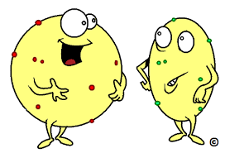
Fact or Fiction – Let’s play!
“Obese” people are “unhealthy,” and “thin” people are “healthy?
Fact or Fiction?

Slide 5
Fact or Fiction – Let’s play!
Eat less, move more?
Fact or Fiction

Slide 6
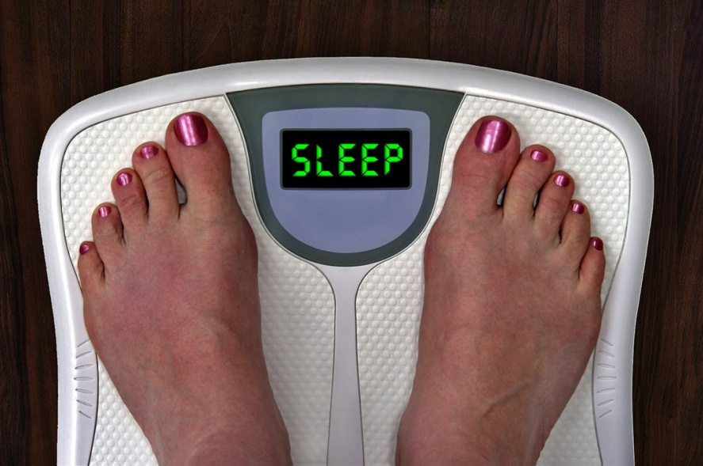
Fact or Fiction – Let’s play!
Sleep Deprivation Causes Weight Gain.
Fact or Fiction?
Notes:
FACT (Angela)
Losing out on sleep creates a viscous cycle in your body, making you more prone to various factors contributing to weight gain. “The more sleep-deprived you are, the higher your levels of the stress hormone cortisol, which increases your appetite.

Slide 7
Fact or Fiction – Let’s play!
Carbohydrates are bad?
Fact or Fiction?
Notes:
FICTION (Connie)
Only simple carbohydrates should avoided (sugar, processed foods, refined grains)
- Causes a spike in blood sugar levels
Full of toxins

Slide 8
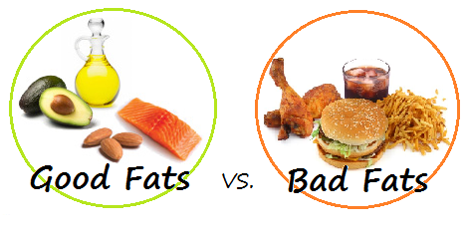
Fact or Fiction – Let’s play!
Eating fat makes you fat!
Fact or Fiction?

Slide 9
Fact or Fiction – Let’s play!
Water is important for weight loss?
Fact or Fiction?

Slide 10
Fact or Fiction – Let’s play!
All “calories” are created equal.
Fact or Fiction?

Slide 11
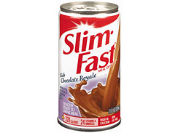
Fact or Fiction – Let’s play!
“Diet” foods can help you lose weight.
Fact or Fiction?

Slide 12
Fact or Fiction – Let’s play!
Losing weight is a healing process?
Fact or Fiction?

Slide 13
Now for the RAW Truth!
A few of our most important health secrets:
Stress levels
Remove toxicity on cellular level
90/10 rule
B.A.L.L.S

Slide 14
What is your “WHY”?

Slide 15
Today, all of you will be blessed with a Complimentary Body Comp Analysis!

Slide 16
SprintSet No Regret!

